Slide 1
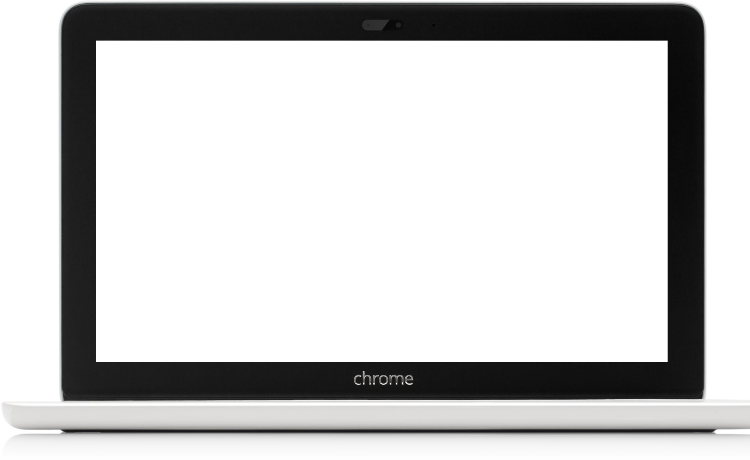
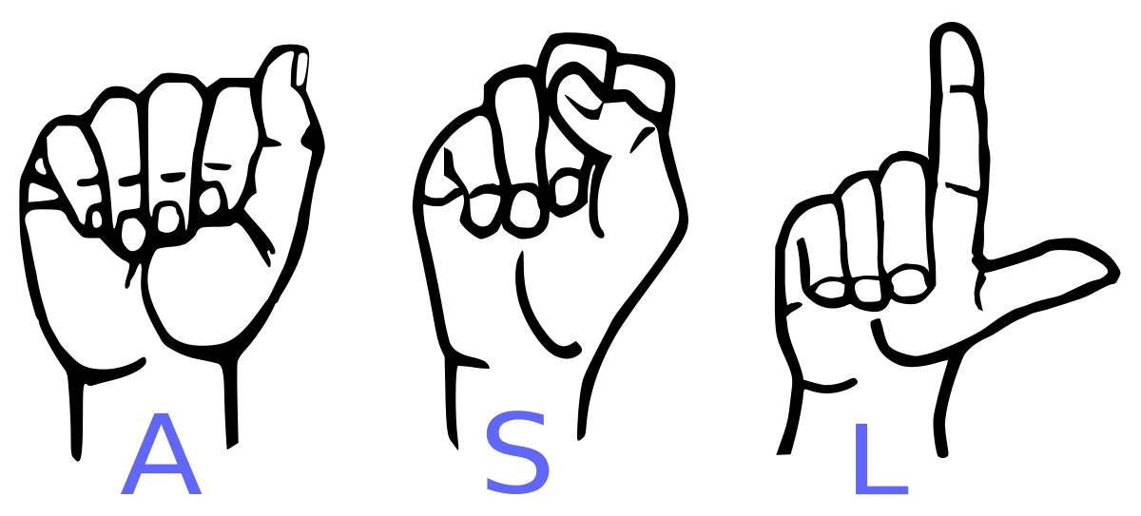
Conversion of Sign Language to Text and Speech
For Dumb and Deaf

Slide 2

Abstract
Our project aims to create a computer application and train a model which when shown a real time video of hand gestures of American Sign Language shows the output for that particular sign in text format on the screen.

Slide 3

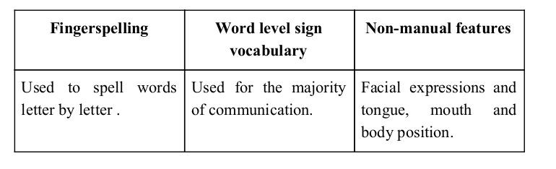
Sign language is a visual language and consists of 3 major components:

Slide 4
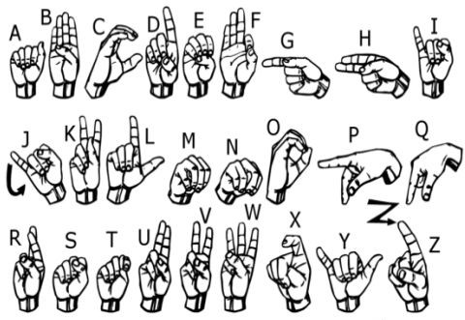
We implemented 27 symbols(A-Z, blank) of ASL in our project.

Slide 5
Methodology

Slide 6
How we generated data set and did Data Preprocessing ?

Slide 7
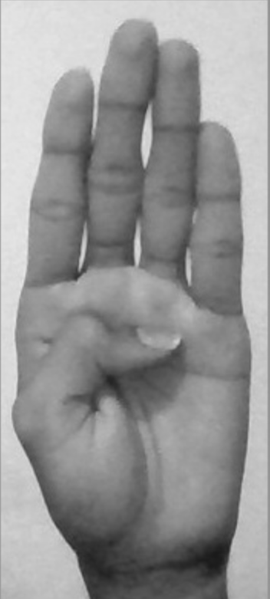
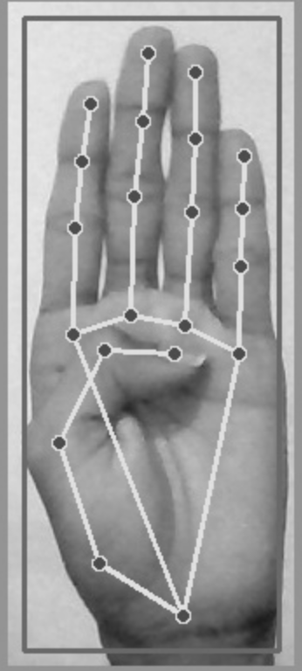
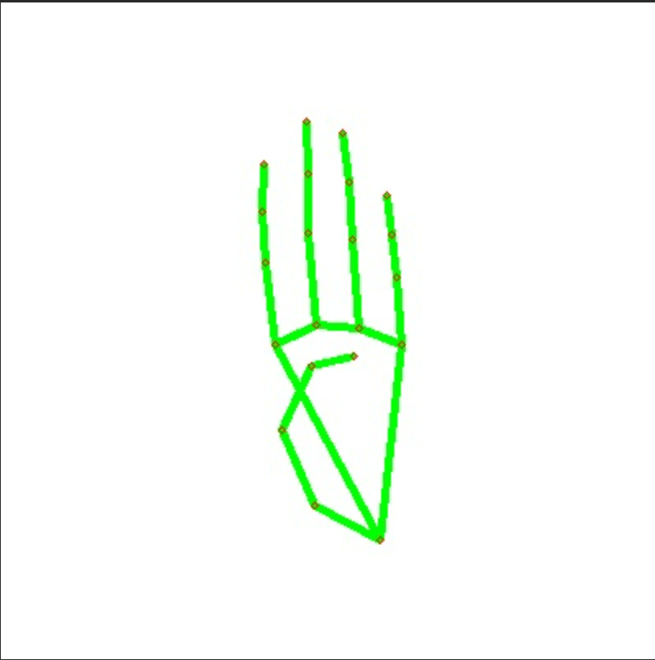
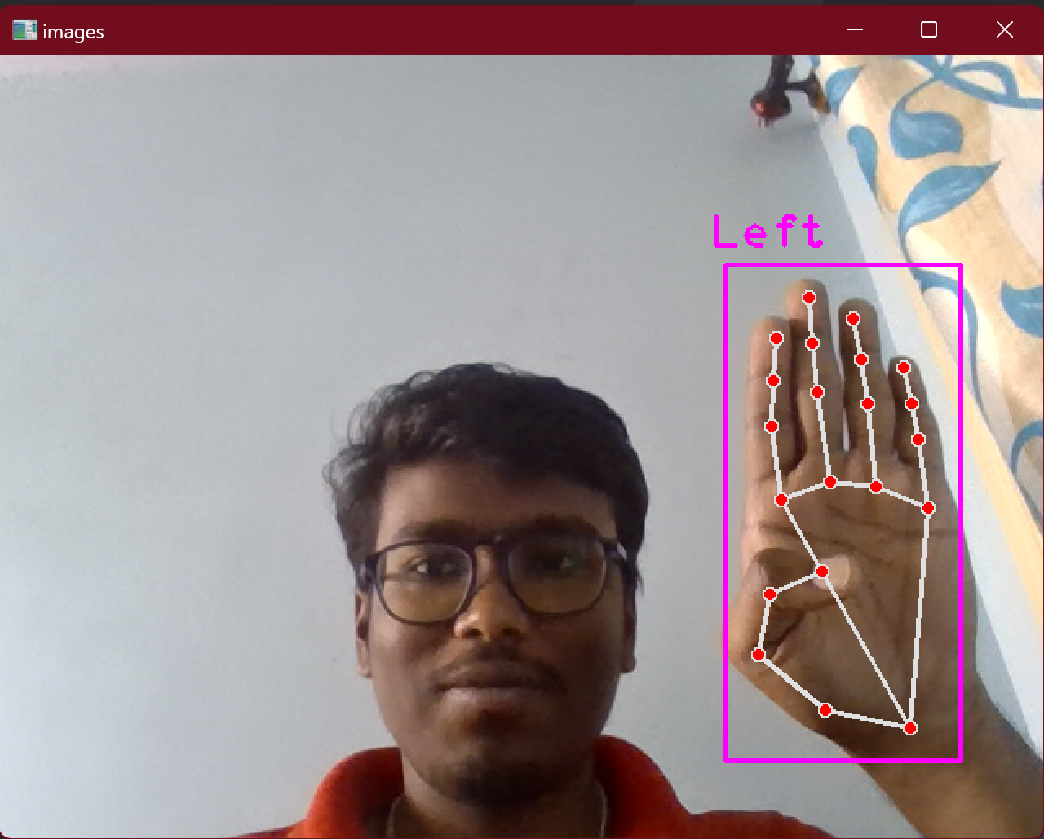
Draw into plain white background
Capturing Raw Image
Gray Scale Image
Landmark Detection

Slide 8
Why we Created our own Dataset ?

Slide 9
➔ For the project we tried to find already made datasets but we couldn’t find dataset in the form of raw images that matched our requirements.
➔ All we could find were the datasets in the form of RGB values.
➔ Hence we decided to create our own data set.

Slide 10
Gesture Classification

Slide 11
Layer 1
Layer 2
Classify between Similar Symbols
Classify between 27 Symbols

Slide 12
Algorithm Layer 1:
Apply gaussian blur filter and threshold to the frame taken with opencv to get the processed image after feature extraction.
This processed image is passed to the CNN model for prediction and if a letter is detected for more than 50 frames then the letter is printed and taken into consideration for forming the word.
Space between the words are considered using the blank symbol.

Slide 13
Algorithm Layer 2:
We detect various sets of symbols which show similar results on getting detected.
We then classify between those sets using classifiers made for those sets only.
In our testing we found that following symbols were not showing properly and were giving other symbols also :
For D
For U
For I
For S
: R and U
: D and R
: T, D, K and I
: M and N

Slide 14
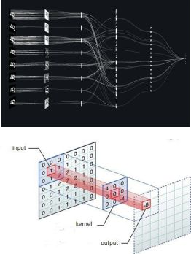
Convolutional Neural Networks
CNNs consist of multiple convolutional layers each layer containing numerous “filters” which perform feature extraction.
Initially these “filters” are random and by training, the feature extraction gets better by better.
It’s primarily used for image classification.

Slide 15
Our CNN Classifier Model

Slide 16
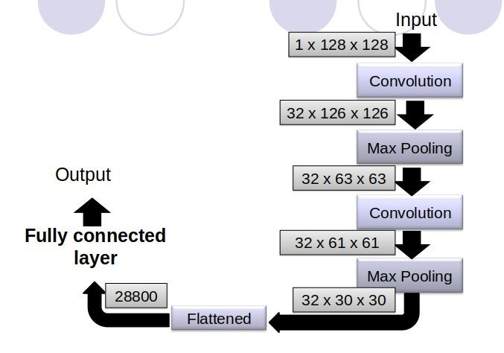

Slide 17
Finger Spelling Sentence Formation

Slide 18
Implementation
Whenever the count of a letter detected exceeds a specific value and no other letter is close to it by a threshold we print the letter and add it to the current string(In our code we kept the value as 50 and difference threshold as 20).
Otherwise we clear the current dictionary which has the count of detections of present symbol to avoid the probability of a wrong letter getting predicted.
Whenever the count of a blank(plain background) detected exceeds a specific value and if the current buffer is empty no spaces are detected.
In other case it predicts the end of word by printing a space and the current gets appended to the sentence below.

Slide 19
Autocorrect feature
A python library enchant_suggest is used to suggest correct alternatives for each (incorrect) input word and we display a set of words matching the current word in which the user can select a word to append it to the current sentence.This helps in reducing mistakes committed in spellings and assists in predicting complex words.

Slide 20
Challenges Faced
We couldn’t find a dataset with raw images of all the asl characters so we made our own dataset.
Second issue was to select a filter for feature extraction. We tried various filter including binary threshold, canny edge detection, gaussian blur etc. ,of which gaussian blur filter was giving better results.
Issues were faced relating to the accuracy of the model we trained in earlier phases which we eventually improved by increasing the input image size and also by improving the dataset.

Slide 21
Software Requirements
Python 3.10.10
Tensorflow 1.11.0
OpenCV 3.4.3.18
NumPy 1.15.3
Matplotlib 3.0.0
Pyenchant 1.0.5
Keras 2.2.1
PIL 5.3.0

Slide 22
Limitations of our model
The model works well only in good lighting conditions.
Plain background is needed for the model to detect with accuracy.

Slide 23
Conclusion
In this report, a functional real time vision based american sign language recognition for D&M people have been developed for asl alphabets.
We achieved an accuracy of 98.00% on our dataset.
Prediction has been improved after implementing two layers of algorithms in which we verify and predict symbols which are more similar to each other.

Slide 24
Future Scope
We are planning to achieve higher accuracy even in case of complex backgrounds by trying out various background subtraction algorithms.
We are also thinking of improving the preprocessing to predict gestures in low light conditions with a higher accuracy.

Slide 25
Efforts by
Project Under Supervision of
Mr.Pradip Kumar Das
Professor of Practice
Semparidhi G
1BG20AI111

Slide 26
Thank You !

